Slide 1
gRPC and usage in ASP .NET 6 Presented by: Kunal Mukherjee
October 13, 2023

Slide 2
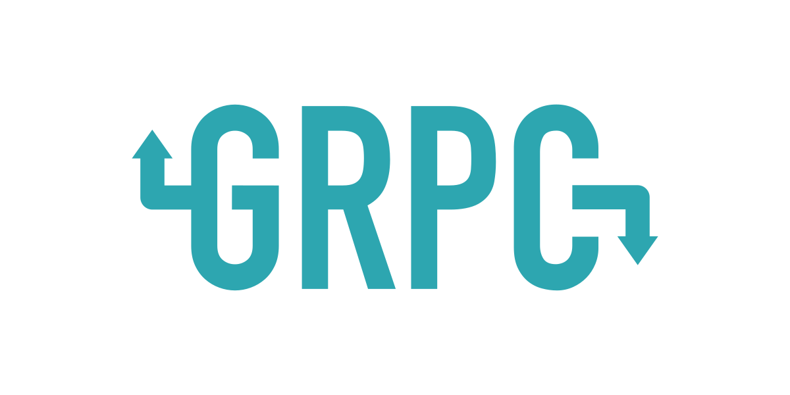
High performance RPC framework used for microservices communication.
Developed by Google in 2016.
Utilizes HTTP/2 as transport.
Uses Protobuf to send data. Protobuf is 100 times more efficient than JSON or XML.
Part of Cloud Native Computing Foundation (CNCF) project.

Slide 3
Why gRPC ?
REST API(s) uses HTTP/1.1
HTTP/1.1 is mostly textual so we can’t represent binary data.
HTTP/1.1 has large header size and cookies.
HTTP/1.1 only allows 6 parallel connections at a time depending on the browser.
With HTTP/1.1 we cannot push data from server. So, we need to use WebSocket as alternative.

Slide 4
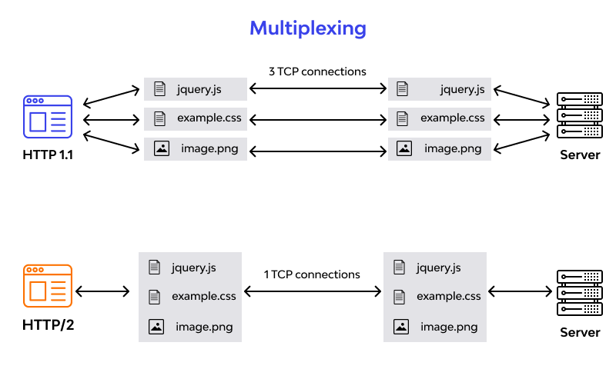
HTTP/1.1 vs HTTP/2

Slide 5
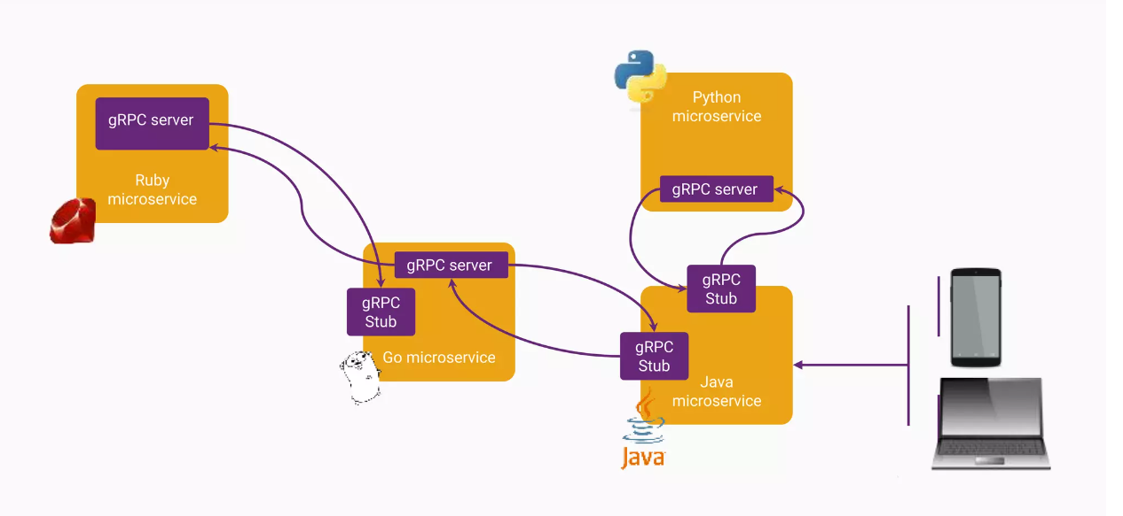
gRPC architecture

Slide 6
Key terminologies
gRPC server –
Listens for incoming requests.
Implements business logic for gRPC services.
Sends responses back to gRPC clients.
gRPC stub (client) –
Generates and sends requests to gRPC server.
Deserializes and processes responses from gRPC server.
Usually, the stub is implemented on a web server that also hosts REST API.

Slide 7
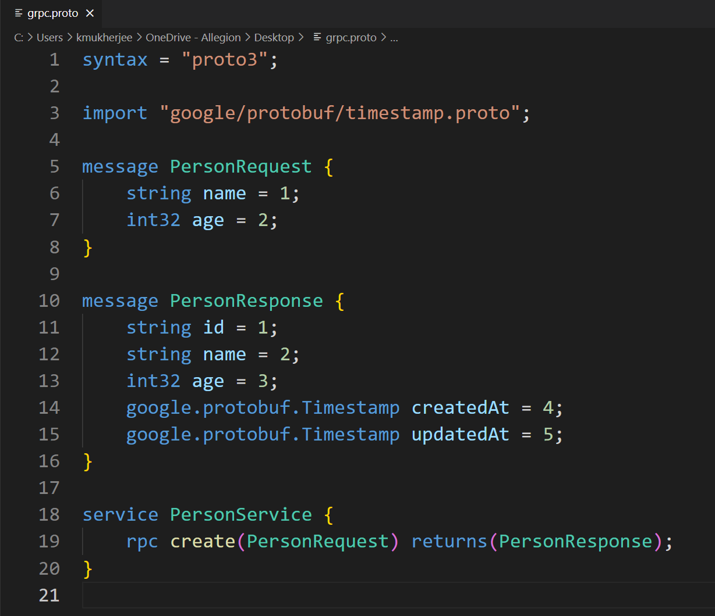
Key terminologies (continued…)
Protobuf –
Google’s representation to serialize structured data that is language-neutral.
Protobuf is a contract shared between the gRPC server and the gRPC stub for code generation in respective programming language.
Protobuf has 2 versions. (version 2 and 3)
Protobuf is strongly typed.

Slide 8
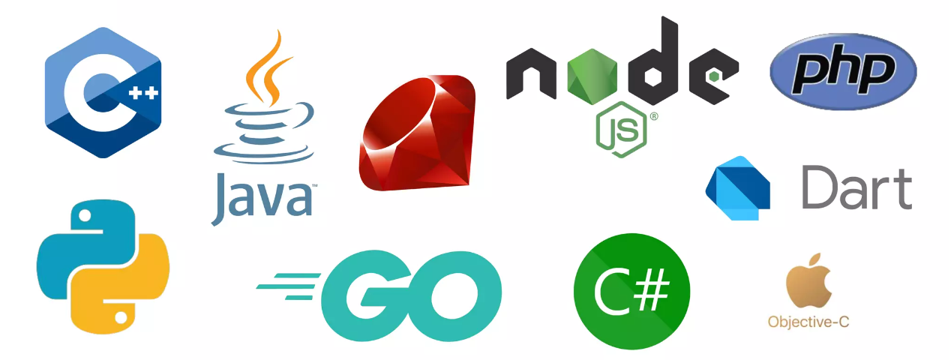
Supported Languages

Slide 9
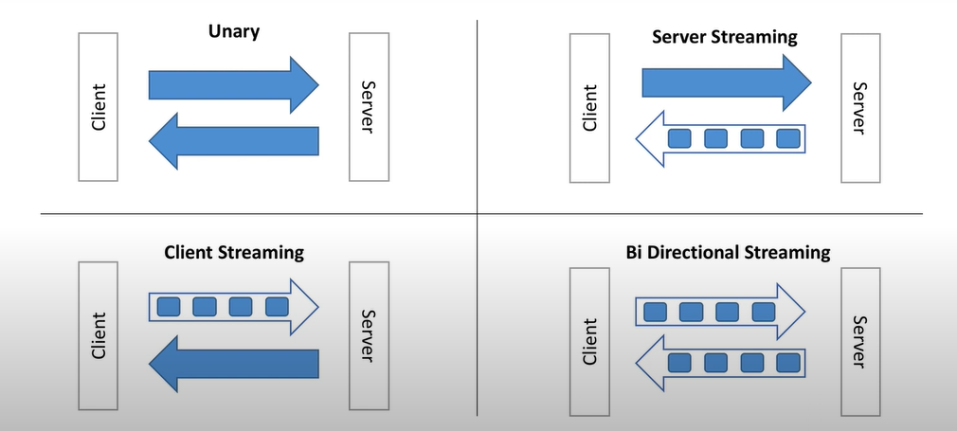
Connection Options

Slide 10
Who uses gRPC in Production ?
Google
Square
Dropbox
Cisco
Juniper Networks
Netflix
Cockroach DB
CoreOS
Uber
Ngrok
+ many more

Slide 11
DEMO

Slide 12
ANY QUESTIONS ?

